Slide 1
Implementing Loop Structures
Shriram K Vasudevan
Notes:
This template can be used as a starter file for a photo album.

Slide 2
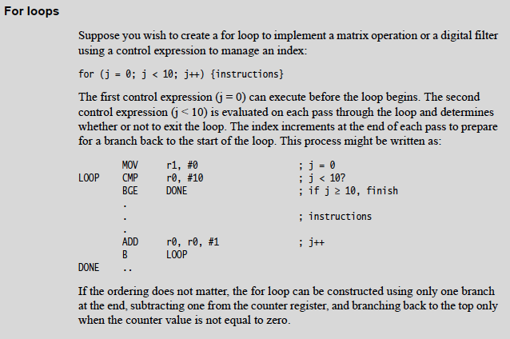
FOR LOOP – An Example code.

Slide 3
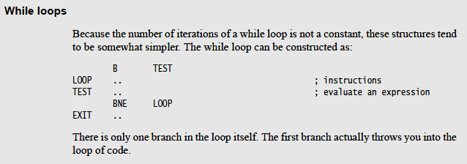
While Loop

Slide 4
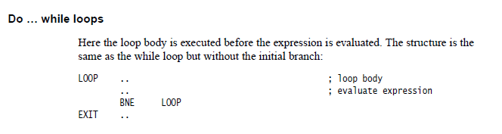
Do while

Slide 5
Thanks.

